Slide 1
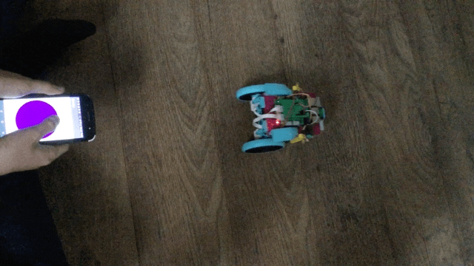
Creating with Raspberry Pi and LEGO Spike Prime

Slide 2
LEGO Education SPIKE Prime: What's in the Box?

Slide 4
Raspberry Pi Build HAT
The Build HAT is part of an exciting new collaboration between Raspberry Pi and Lego Education to increase the impact and reach of STEAM learning.​

Slide 5
Process
Use a LEGO Spike Prime and the Raspberry Pi Build HAT to build a robot car
Then program it so you can control it with a Bluetooth connection from your Android/Apple phone.

Slide 6
Spike Prime Design Guide
A: Medium Motor
B: Force Sensor
C: Color Sensor
D: Large Motor
F: Medium Motor
E: Distance Sensor

Slide 7
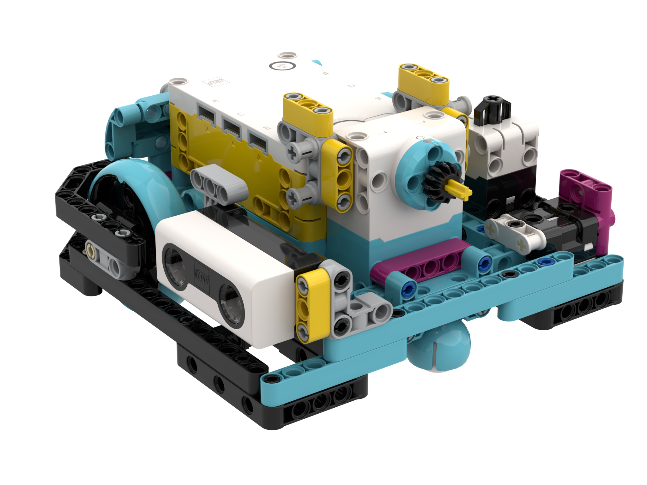
Lego Spike Prime is our project robot.
It only uses parts available in the SPIKE Prime Set (45678). No Expansion Set needed.
All sensors are pre-mounted for use in our lessons
The wheel size is 56mm and the motors and sensors are configured as below.
Build instructions have been provided for building this robot.

Slide 8
Before you begin
*You will need to have your Raspberry Pi computer set up and attached to your Build HAT.

Slide 9
Mounting the Raspberry Pi
Line up the Build HAT with the Raspberry Pi, ensuring you can see the This way up label.
Make sure all the GPIO pins are covered by the HAT and press down firmly.

Slide 10
Power up!
You should now power your Raspberry Pi using the 7.5V barrel jack on the Build HAT, which will allow you to use the motors.

Slide 11
Set up the LEGO Spike motors
The Raspberry Pi Build HAT and its Python library allow you to control LEGO Technic motors directly from your Raspberry Pi computer.

Slide 12
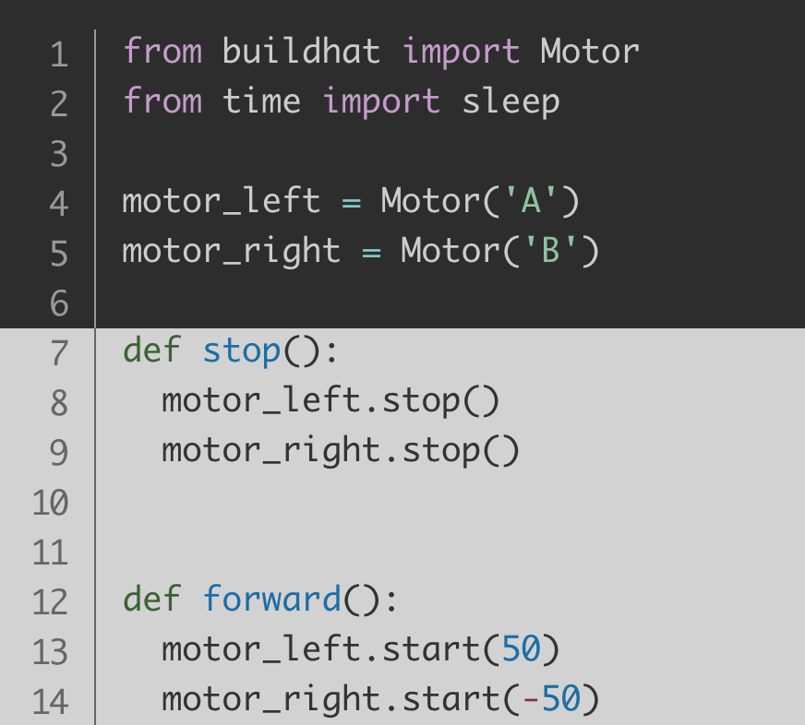

Slide 13
Please note how the basic ports are configured on the diagram on the right. Since all the sensors cannot start off connected to the Hub, you will have to disconnect ports so you can add the Distance and Force Sensors used in our lesson.

Slide 14
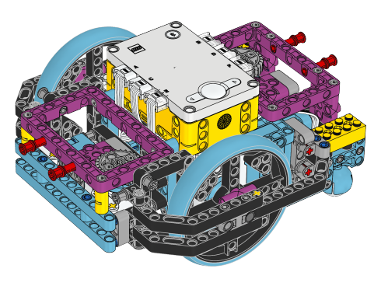
Advanced Driving base
You can also use the Advanced Driving Base (ADB).
It will require the SPIKE Prime Set (45678) as well as the SPIKE Prime Expansion Set (45680).
Instructions to build this model are available inside the SPIKE Prime and software online:
https://education.lego.com/en-us/lessons/prime-competition-ready/assembling-an-advanced-driving-base
Please note how the basic ports are configured on the diagram on the right. Since all the sensors cannot start off connected to the Hub, you will have to disconnect ports so you can add the Distance and Force Sensors used in our lessons
The color sensors on ADB are also not optimally positioned for using in Color Mode. (see next slide)

Slide 15
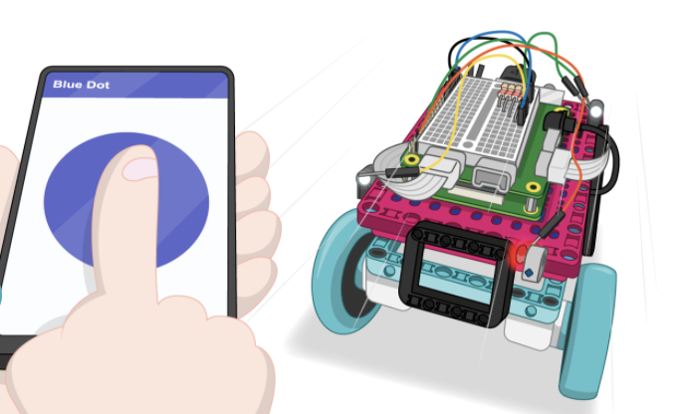
LEGO Spike Prime remote-controlled car
projects.raspberrypi.org/en/projects/lego-robot-car/2

Slide 16
Project Resource Links

Slide 17
#APSCODES2021 #CSEdWeek
@DavidJLockett

